Slide 1

RealEase: Comprehensive Real Estate Insights Platform
Milestone 6 Overview
By Donovan Murphy, Jonathan Bailey, and Enrique Obregon

Slide 2
Milestone Overview
Market Insights Dashboard
Local DB Caching for Search and Insight
ROI Visualization
Complete Demo’s

Slide 3
Milestone 5 Plan
Task | Donovan | Jonathan | Enrique
1. Finish Neighborhood Insights Dashboard | implement/test 40% | Research 20% | Research/implement 40%
2. Test all tools thoroughly | Design 50% | Design 25% | Design 25%
3. Touch up anything as suggested by advisor and or instructor | Implement 40% | Implement 30% | Implement 30%
4. Integrate with python everywhere | Research and implementation 60% | Research 20% | Research 20%

Slide 4
Task 1: Market Insights Dashboard
Provide the user with valuable market trends and averages
Minimal Latency
&
Graphs

Slide 5
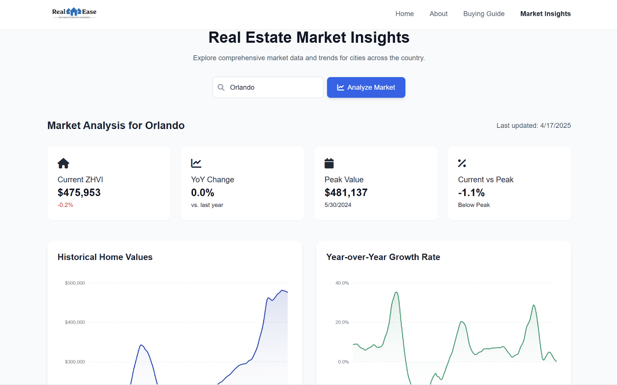
Task 1: Demo Image

Slide 6
Task 2: Local DB Caching and Latency
We cache searched locations in our database, so if a user searches one we've already stored, it loads instantly, cutting down latency and avoiding repeat API calls.
Market data is stored in our database and directly powers the interactive menu, making trends and insights load seamlessly and in real time.

Slide 7
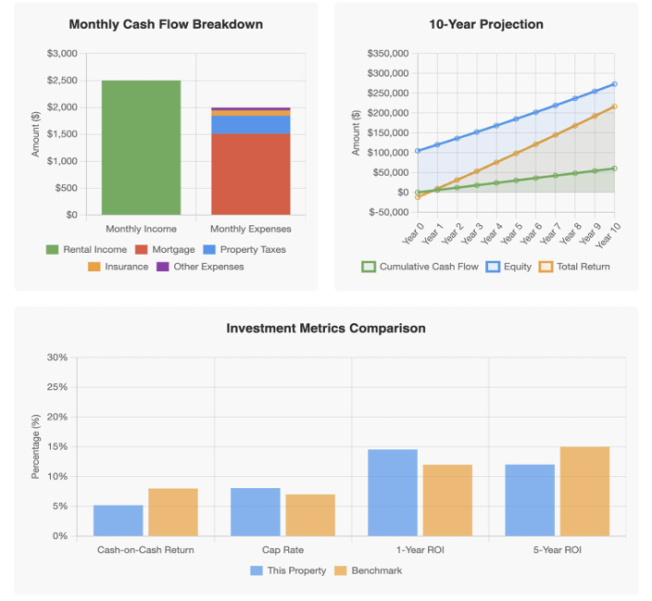
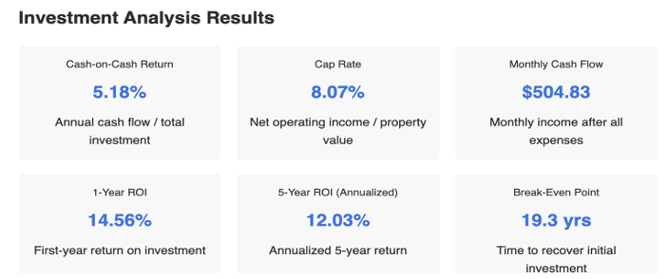
Task 3: ROI Visualization
Our enhancements to the ROI calculator transformed it from a basic ROI tool into a comprehensive platform with powerful visual elements.

Slide 8
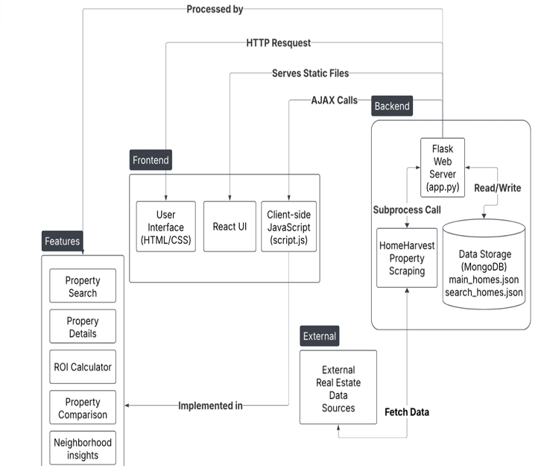
Task 4: System Architecture Diagram

Slide 9
Showcase Preparation Plan
Task | Donovan | Jonathan | Enrique
1. Finish Neighborhood Insights Dashboard | implement/test 40% | Research 20% | Research/implement 40%
2. Test all tools thoroughly | Design 50% | Design 25% | Design 25%
3. Touch up anything as suggested by advisor and or instructor | Implement 40% | Implement 30% | Implement 30%

Slide 10
Task 1: Rehearse Elevator Pitch
Unique Features
Speak to all 3 tools

Slide 11
Task 2: Ensure All Demo Equipment is Working
Test laptops, monitors, and internet connectivity to verify compatibility with our live site
Confirm that all RealEase features—Market Insights Dashboard, Home Comparison Tool, ROI Calculator, and Home Search—load quickly and display correctly

Slide 12
Task 3: Touch Up Based on Feedback
Update Dashboard Layout
Ease of Use

Slide 13
Faculty Advisor Feedback
Tool Evaluation
Have working Demos of each feature at the showcase
Poster
Minimize the number of paragraphs and use bullet points instead
Preparation
Practice delivering an elevator pitch

Slide 14

Questions?

